Slide 1

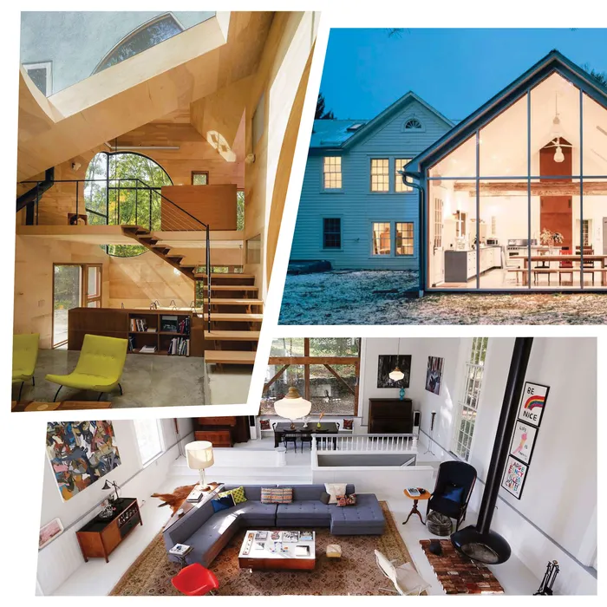
BA476 Group 3
Airbnb in NYC
Goal: find variables that influence Airbnb listing prices the most and be able to predict the price of an Airbnb
By: Kimberly Merida, Ken Ye, Benjamin Herold,
Jamie Phan,Dongze Zhao
Notes:
Kim - Hi this is group 3 and today we will be presenting your findings about airbnb prices in NYC
the goal is ….

Slide 2



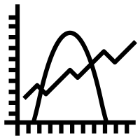

Why this dataset?
Airbnb
Investigate Variables
Construct a model
It can be an interesting case study as the popularity of the “gig economy” increases
Investigate potential problematic variables that impact Airbnb and their listing prices
Use dataset to construct a model to assist with our findings
Notes:
Kim - We thought this dataset would be interesting since Airbnb’s future is unknown with the gig economy becoming more popular
Therefore we want to check to see which variables impact Airbnb’s prices the most so we constructed different models to help us with our findings

Slide 3






Agenda
Overview
Linear Regression
Lasso Regression
Ridge Regression
KNN
Trees Method
Notes:
Kim - For Today’s Presentation we will be going over details about our datasource as well how our dataset did with a linear, lasso, and ridge regression, KNN, and the trees method.

Slide 4
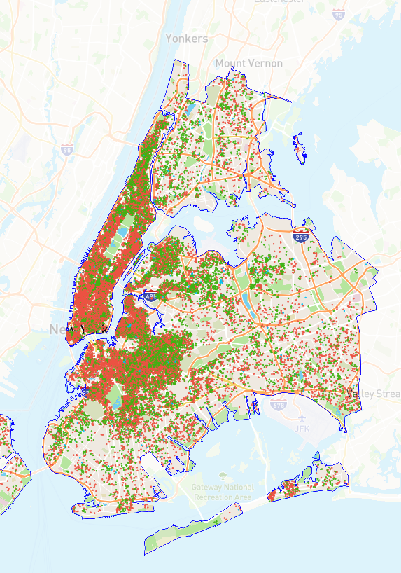
Data Source
Training Dataset:
33199 Randomized Observations
Maximum value (Y_Train): 19,750
Mean (Y_train): 214.340
Our dataset is on Airbnb prices in NYC (2022) from Kaggle
Testing Dataset:
8300 Randomized Observations
Maximum value (Y_test): 10,000
Mean (Y_test): 213.255
Notes:
Jamie
Our dataset is on Airbnb listing prices in NYC in 2022. We originally sourced a dataset for 2019 from Kaggle but found an updated version of the dataset for 2022 from Inside Airbnb, a community project aggregates data and provides advocacy about Airbnb’s impact on residential communities. I will be going deeper into the original dataset in the next slide.
After going through our data cleaning process, we ended up with 33,199 randomized observations for our training dataset and 8300 randomized observations. In terms of our cleaning, we dropped outliers such as observations where listing prices were just 0 or listing prices over 60,000. The maximum value in our Y_train …

Slide 5
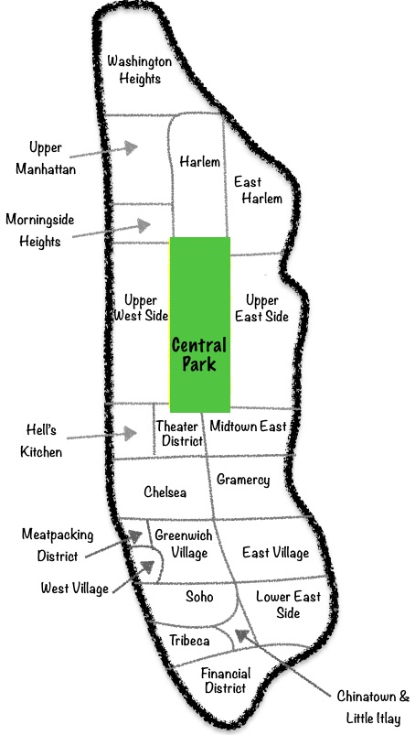
Our Data Set
Some Important variable
name | name of the listing
description | Detailed description of the listing
calculated_host_listing_counts | The number of listings the host has in the current scrape, in the city/region geography
room_type | entire home/apt, private room, shared room
availability_365 | avaliability_x. The availability of the listing x days in the future as determined by the calendar. Note a listing may not be available because it has been booked by a guest or blocked by the host.
price | price for the location
reviews_per_month | reviews per month
neighbourhood | which neighbourhood is on
41533 Rows
With 16 Columns
3 Data Types
Mainly int64
Notes:
Jamie
As you can see here, our original dataset came with 16 columns and 41533 rows. The original dataset includes a variety of variables:...

Slide 6


Naive Baseline
385.0395
Predictors: 'minimum_nights', 'number_of_reviews', 'availability_365', Room Type (' Entire home/apt', 'Hotel room', 'Private room', 'Shared room'), Location ('Bronx', 'Brooklyn', 'Manhattan', 'Queens', 'Staten Island')
Naive Baseline RMSE (Test) for Benchmarking
Notes:
Jamie
We ultimately decided to use 13 variables in our models. Our predictors are…

Slide 7
Linear Regression
Intercept | 170.471
Minimum_nights | -0.980
Number_of_reviews | -0.359
Availability_365 | 0.287
Entire home/apt | 14.315
Hotel room | 156.469
Private room | -61.952
Shared room | -108.833
Bronx | -57.961
Brooklyn | 1.561
Manhattan | 132.759
Queens | -28.953
Staten Island | -47.406
RMSE Train
392.872
RMSE Test
372.879
Even though the training and testing datasets have the similar mean, the max value in our Y_train dataset is 9750 higher than the max value in our Y_test dataset
Notes:
Ken

Slide 8
Linear (Backwards Stepwise) Regression
Intercept | 112.404
Minimum_nights | -0.980
Number_of_reviews | -0.359
Availability_365 | 0.287
Entire home/apt | 42.32
Hotel room | 184.599
Private room | -33.842
Shared room | -80.673
Bronx | -27.91
Brooklyn | 31.599
Manhattan | 162.802
RMSE Train
392.976
RMSE Test
372.839
Our Backwards Stepwise regression filtered out the two variables with a P value greater than 0.05 (Queens and Staten Island)
Notes:
Ken

Slide 9
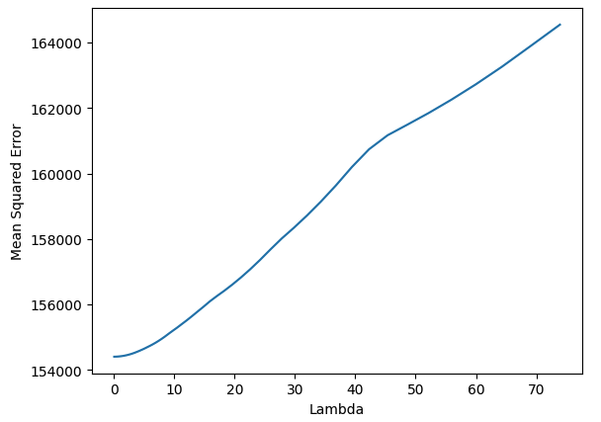
Lasso Regression
Minimum_nights | -29.570
Number_of_reviews | -20.042
Availability_365 | 41.300
Entire home/apt | 37.752
Hotel room | 13.465
Private room | -0.
Shared room | -5.218
Bronx | -11.309
Brooklyn | 0
Manhattan | 64.675
Queens | -10.983
Staten Island | -4.724
RMSE Train
392.872
RMSE Test
372.874
Lasso Lambda: 0.073904
Our Lasso Regression excluded Private Room and Brooklyn
Notes:
Jamie

Slide 10
Ridge Regression
Minimum_nights | -29.649
Number_of_reviews | -20.126
Availability_365 | 41.373
Entire home/apt | 19.189
Hotel room | 11.206
Private room | -18.521
Shared room | -9.511
Bronx | -18.749
Brooklyn | -18.654
Manhattan | 45.724
Queens | -24.997
Staten Island | -8.577
Ridge Lambda: 10.0
RMSE Train
392.872
RMSE Test
372.879
Using the defaulted Leave-One-Out Cross Validation, RidgeCV returned to us a higher lambda value. Although Ridge did not exclude Brooklyn and Private Room, it returned negative coefficients
Notes:
Ben

Slide 11
K-Nearest Neighbors
Predictors:
[minimum_nights, number_of_reviews, availability_365]
Train RMSE: 395.607
Test RMSE: 392.812
Notes:
Ben

Slide 12



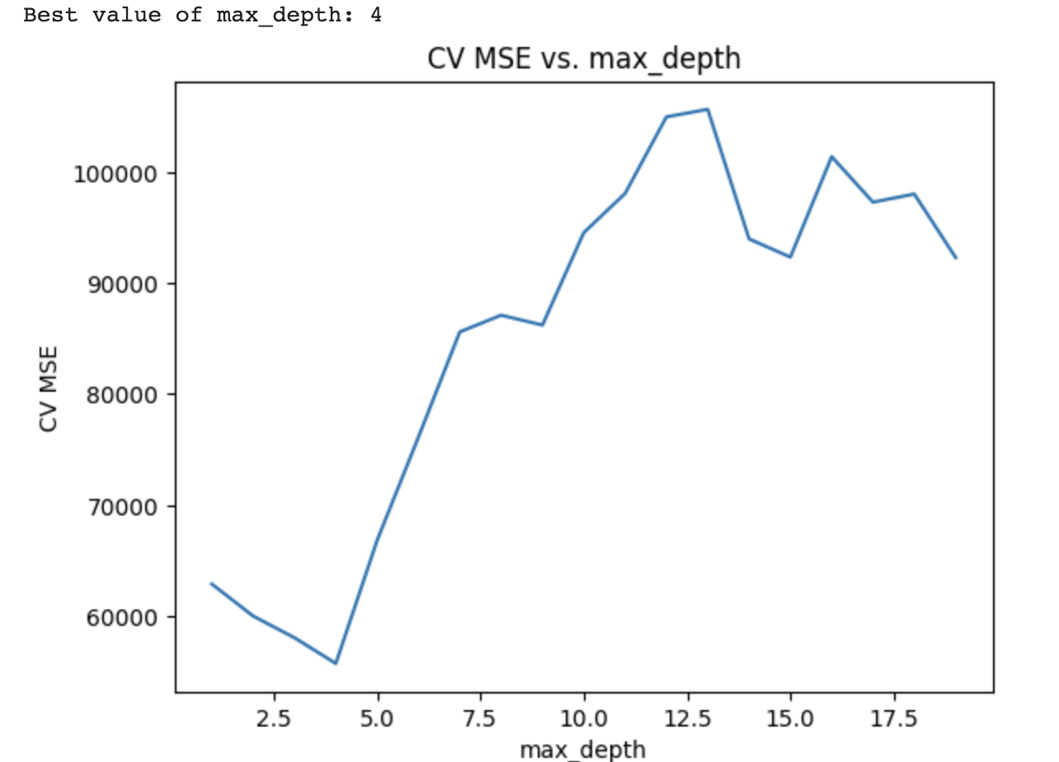
Decision Tree + Random Forest
Cross Validation
The best depth is 4
Decision Tree
RMSE (training): 319.85
RMSE (test): 366.42
Random Forest
Random Forest RMSE (training): 322
Random Forest RMSE (test): 352.77
Notes:
DZ
If it is an entire home/apartment, the price would be $256.28.
If the number of reviews is less than 0.5, the value would be $341.60, which is higher than the listings with more reviews.
If the availability for the listing is more than 349 days, the price would be $497.58.

Slide 13


Decision Tree Example
If it is an entire home/apartment, the price would be $256.28.
If the number of reviews is less than 0.5, the value would be $341.60, which is higher than the listings with more reviews.
If the availability for the listing is more than 349 days, the price would be $497.58.
Notes:
Dz

Slide 14
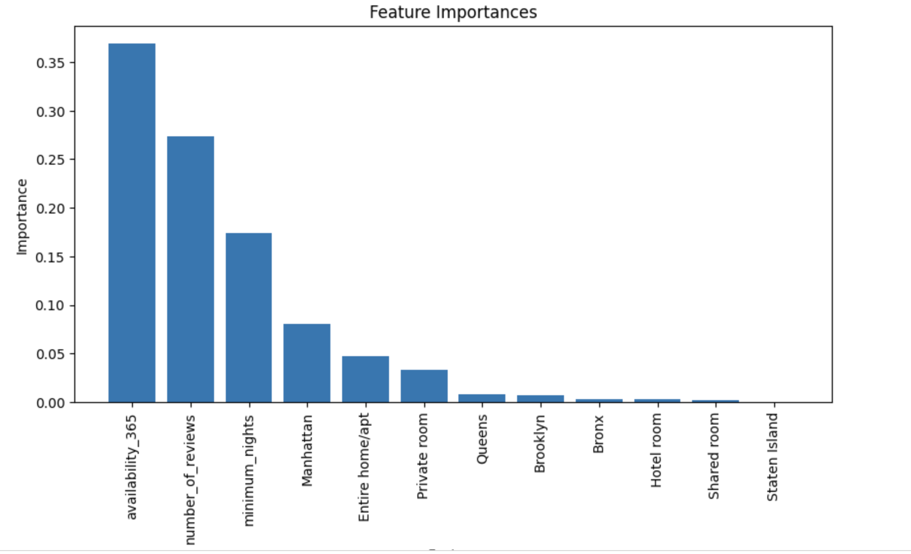
Feature of Importance
importance feature
1 0.368846 availability_365
2 0.273389 number_of_reviews
3 0.173820 minimum_nights
4 0.080668 Manhattan
5 0.046877 Entire home/apt
availability_365: Higher availability may lead to higher prices due to increased demand or costs related to property maintenance.
number_of_reviews: More reviews can indicate a popular listing, potentially allowing for higher pricing, while fewer reviews may require lower pricing to attract guests.
minimum_nights: Higher prices may be set for shorter stays to compensate for additional cleaning and management efforts between guests.
Notes:
Dz

Slide 15
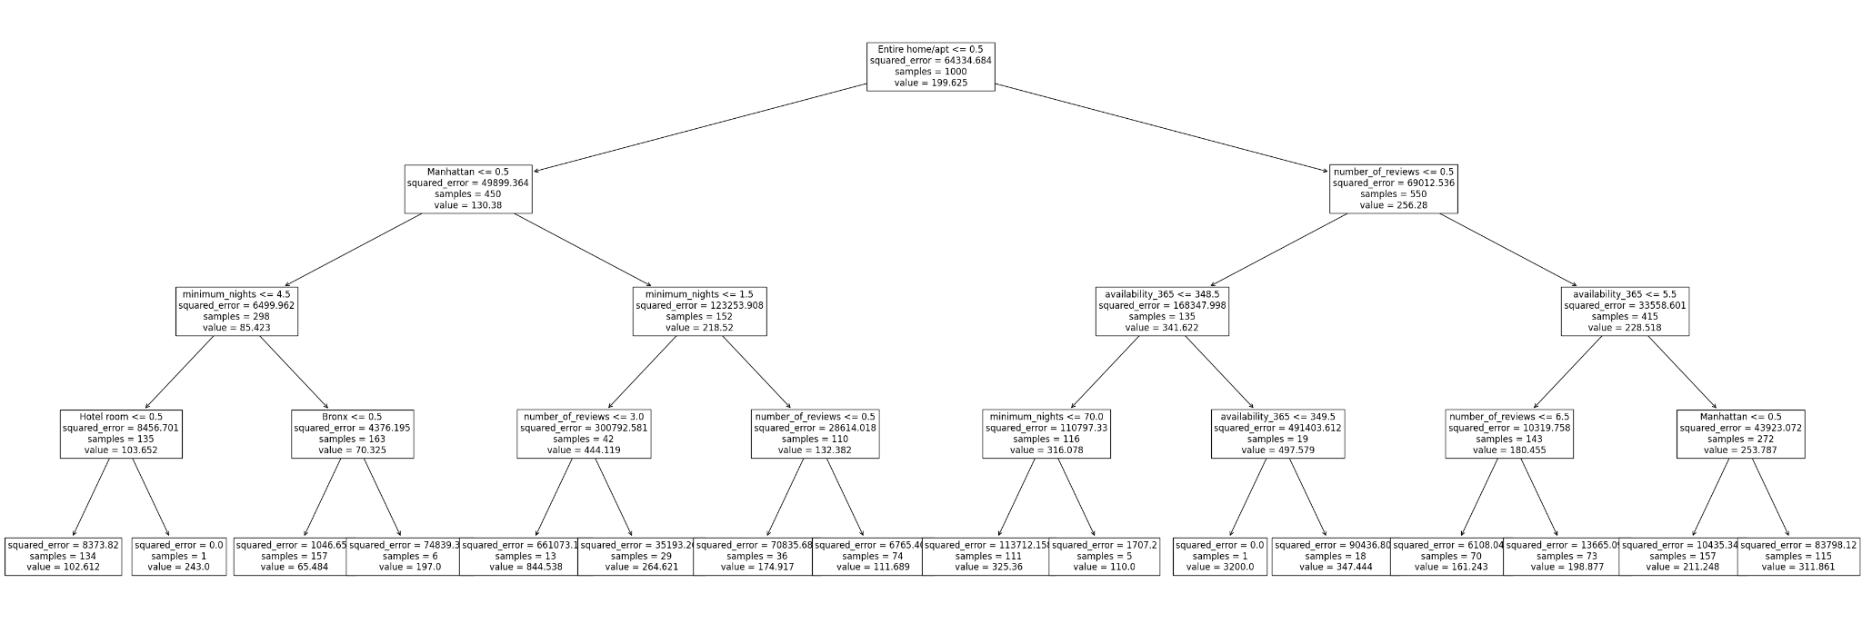
Notes:
Dz

Slide 16
Boosting
Decision Tree Boosting:
Number of Reviews: 0.547
Manhattan: 0.38
Availability_365: 0.072
Train RMSE: 464.618
Test RMSE: 456.614
Notes:
Ken: MSE is best for Decision Tree & Random Forest comparatively to the baseline

Slide 17
Model | Baseline | Linear | KNN | Decision Tree | Random Forest
RMSE | 385 | 372 | 392 | 366.42 | 352.77

Slide 18
Thank you!
Notes:
Ken

